Slide 1
Get your game on with C# and unity
Justin Morgan and Jon Perkins

Slide 2

Unity – What is it?
What is Unity?
Why use it?
Can I get it?
How much does it cost?

Slide 3

Getting started – Lights, Camera… Assets!
Scene
Lights
Camera
Assets
Folder Structure
Unity Assets Store
Model
Model Files
Textures
GAMES

Slide 4
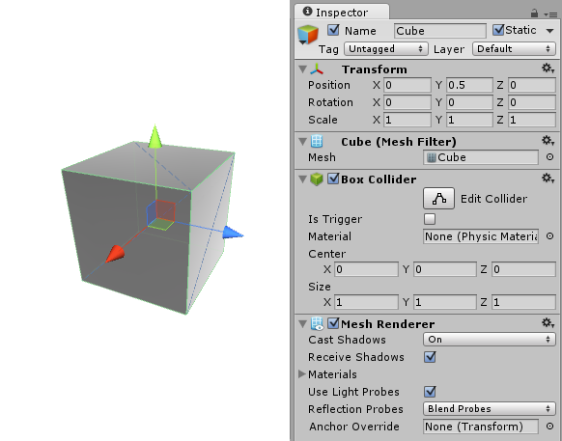
Game Object
What is this?
Why do I care?
Components
Transform
MeshFilter
Renderer
Rigidbody
Scripts

Slide 5
Movement
Create C# script
Start() method
Update() method
“Think in 60th of a second…” ~ Wise Game Dev
User Inputs
Keyboard Controls

Slide 6

Physics
Rigidbodies
Rotation
Velocity and Relative Force

Slide 7
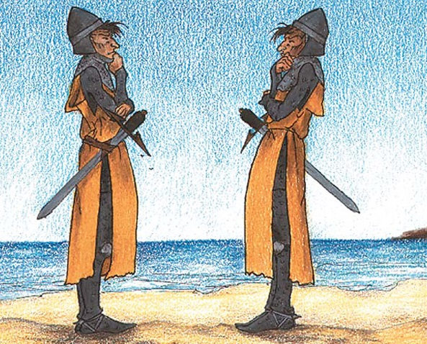
instantiation
Prefab
Library of preconfigured Game Objects
Template Games Objects
Guaranteeing exact copies of Game Objects
Scene Controller
Scene transitions
Separation of concerns
Managing the chaos of Game Object interactions

Slide 8
Shooting
Create a Shot Prefab
Spawn Locations
Shot timer
Delta time
Destruction of Game Object
Memory leaks

Slide 9

Collision Detection
Colliders
Physics Collider
Trigger Collider
Reasons to Use Each Collider
On Trigger Methods
Enter
Exit
Stay
Which Object Should Handle Collisions?

Slide 10
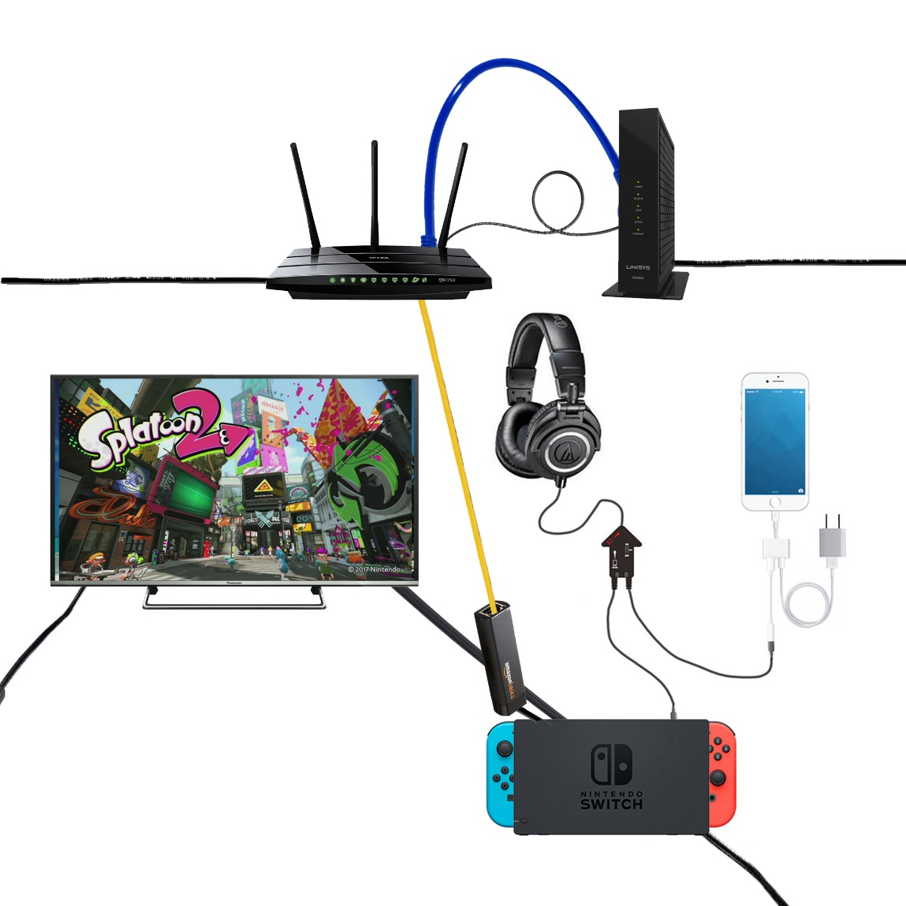
Messages
Why use Messages?
Sending a Message
Broadcasting a Message
Receiving a Message

Slide 11
Tips, Tricks, and Best Practices
Don’t fight against Unity
Game Objects are not C objects (think smaller)
Use messages to communicate between objects
Utilize the Asset Store
Plan first, then code
Have fun

Slide 12

Questions?

Slide 13

Contact
Jon “Perk” Perkins -
Email: perk@handcannongames.com
Twitter: @jperktweets
Justin Morgan –
Email: justin@handcannongames.com
Twitter: @nascentninja
Hand Cannon Games
Twitter: @handcannongames
Never Not Shooting: Get it here!

Slide 14
Links
Git Hub Project: http://tiny.cc/HCGcomSpark
Download Unity3D
Learn more about Unity3D
Unity Asset Store

